Slide 1


Slide 2

Final Year Project-I
(Final Evaluation)

Slide 3
Smart Baby Incubator
Project Group Members:
Wadood Bin Habib 16F-8363
M . Usama Atta 16F-8390
Hassan Mansoor 16F-8399
Project Supervisor:
Dr . Syed Ali Mohsin
Co-Supervisor:
Engr . Umar Farooq

Slide 4
Table of Contents:
Problem Statement
Literature Review
Proposed Work
Methodology
Software and Hardware
Work Breakdown Structure
Results

Slide 5
Problem Statement:
To implement current technologies in order to automate the temperate, humidity and light intensity on moderate levels for premature babies. Can it protect incubator from fire and continuously monitor baby’s heartbeat?

Slide 6
Literature Review:
Learned terminology from the Past Research Papers.
Remote Monitoring of a Premature Infants Incubator (2020)
ThingSpeak, humidity control
Intelligent baby incubator (2018)
ESP8266, IoT modules
System for remote monitoring and control of baby incubator and warmer (2016)
Remote monitoring
Temperature monitoring system for infants incubator using Arduino (2015)
Temperature controlling and Monitoring

Slide 7
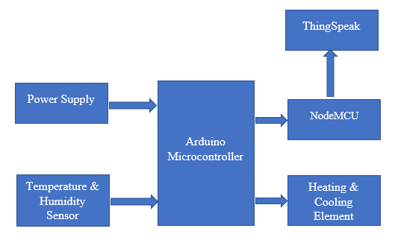
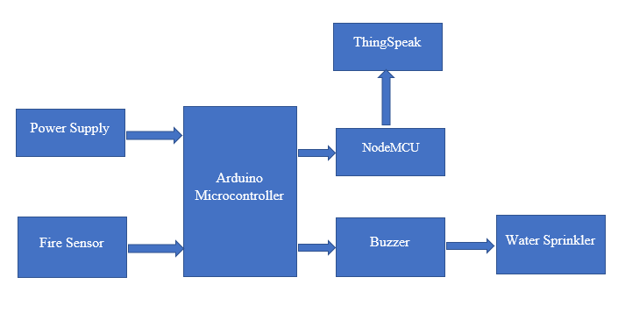
Individual Block Diagram’s of Proposed Work :

Slide 8
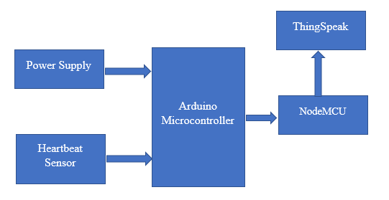
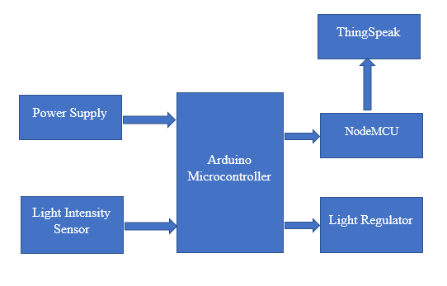
Continue….

Slide 9
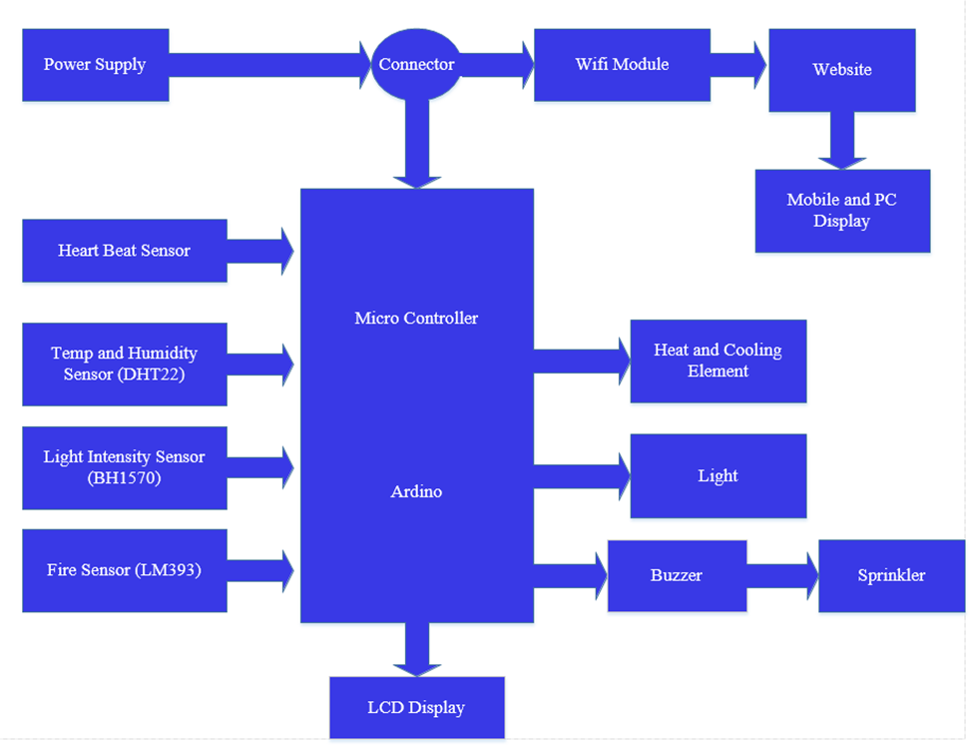
Block Diagram of Main Modules:

Slide 10
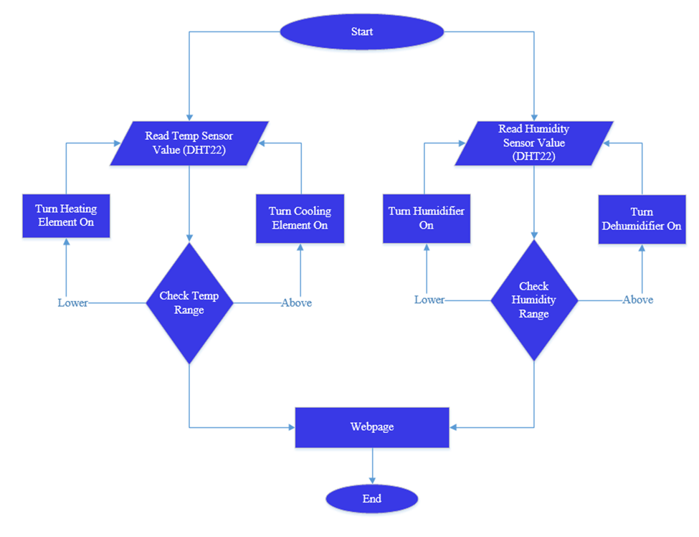
Flow Chart of Main Process:

Slide 11
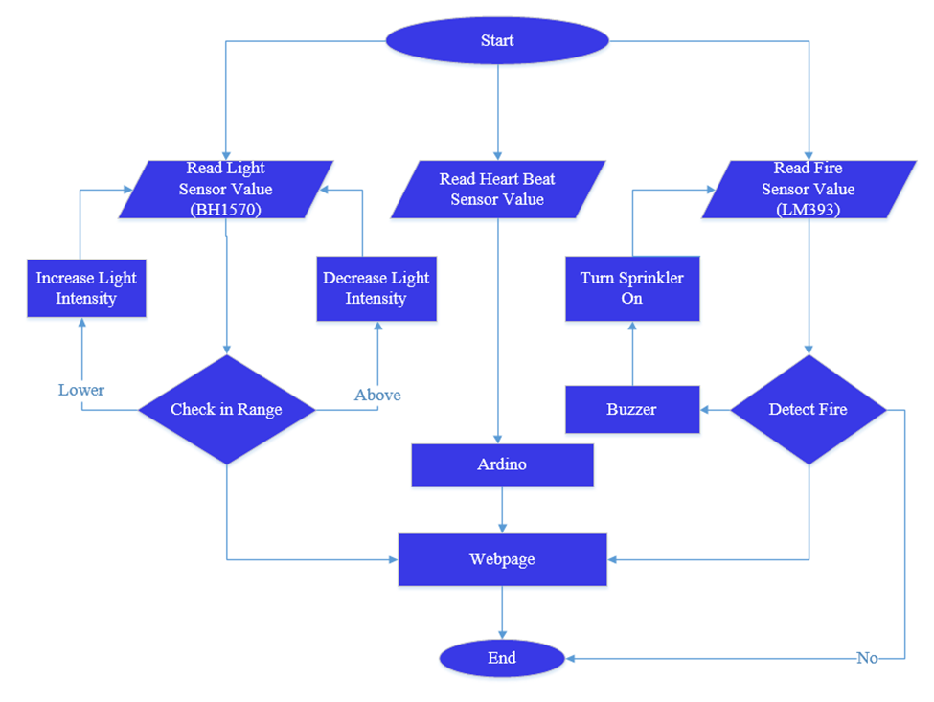
Continue….

Slide 12
Methodology:
There Six main processes in their flow chat to achieve these requirements are Given bellow:
Adjust the baud for serial data transmission rate and com port.
Established connection.
Sensors measured reading send to Arduino board.
Arduino board read the data sent by sensors.
After reading the Sensors data and Processing these values. Arduino displays the output on the LCD Display Screen.
Then Arduino Board Actuates the Actuators accordingly.
Arduino Board is also connected to the NodeMCU that Sends Data Online to Thingspeaks.

Slide 13
Software and Hardware Implementation:
Hardware:
Arduino UNO
NodeMCU
Temperature and humidity sensor (DHT22)
Heartbeat sensor
Flame sensor
Light Intensity sensor
LCD display
Actuators
Alarm

Slide 14
Software:
Proteus Design Suite
Arduino IDE

Slide 15
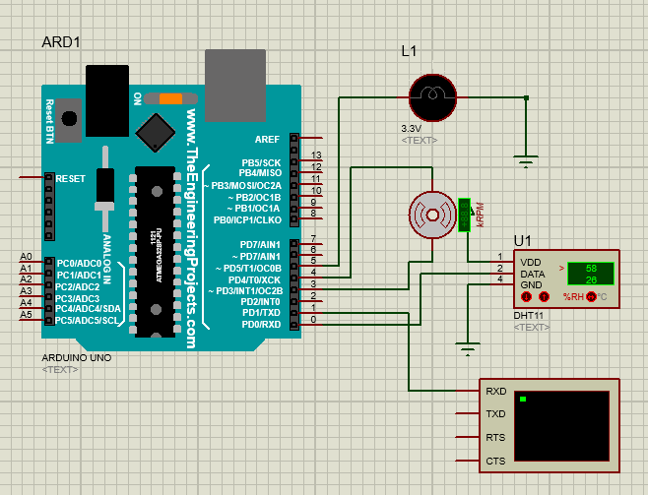
Results:
DHT11 Sensor with Arduino:

Slide 16
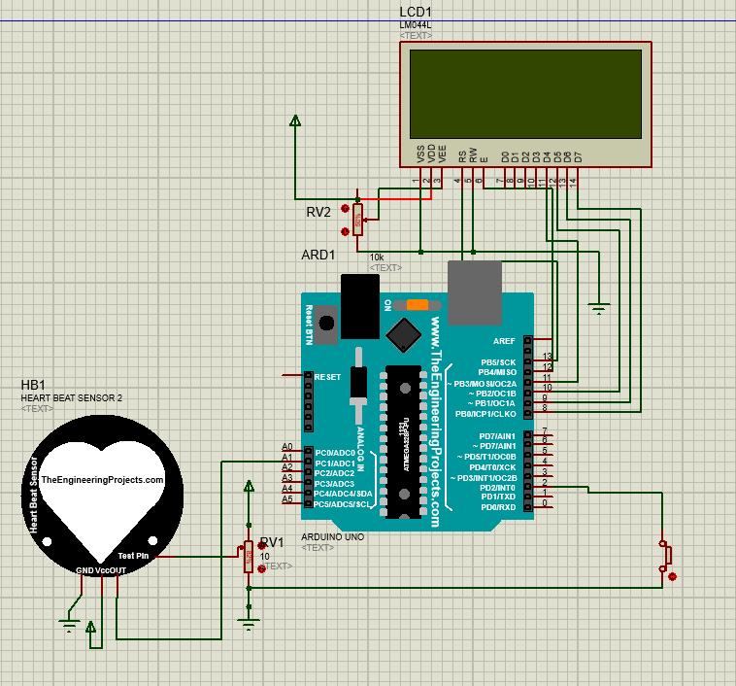
Heartbeat sensor with Arduino:

Slide 17
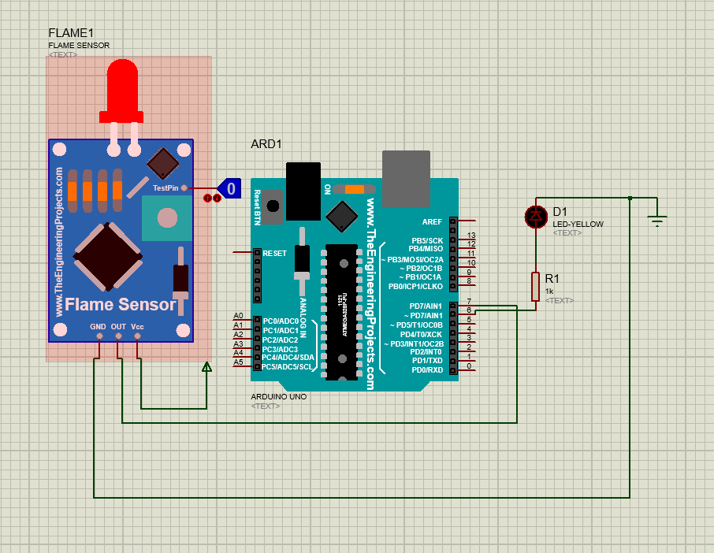
Flame sensor with Arduino:

Slide 18
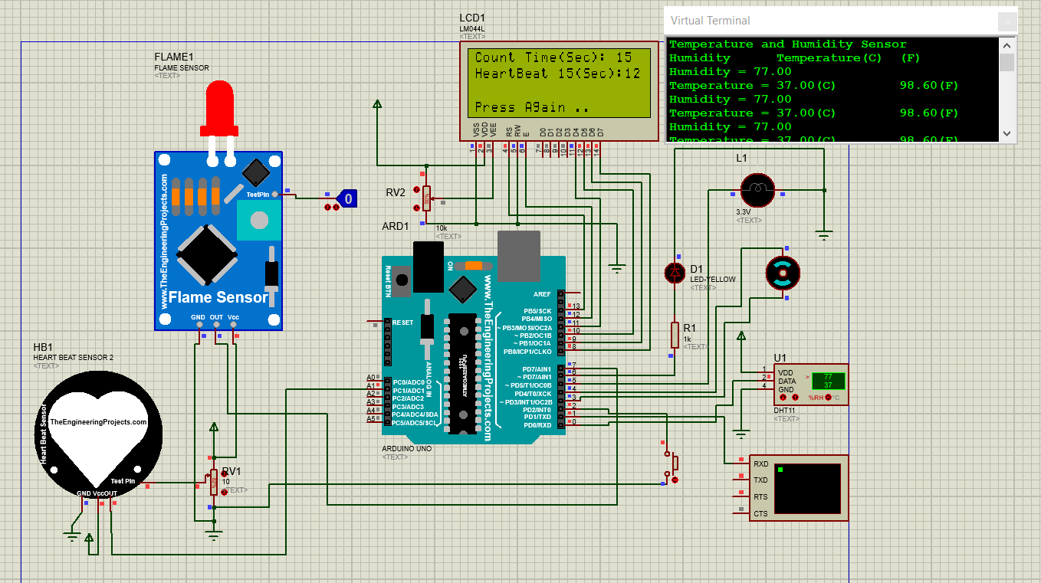
Complete Circuit with Output:

Slide 19
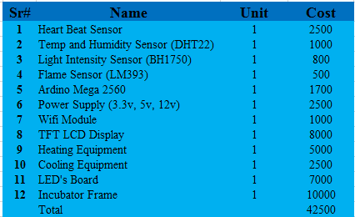
Budget:

Slide 20
References:
[1]https://www.researchgate.net/profile/Ali_AlAskery/publication/337186781_Remote_monitoring_of_a_premature_infants_incubator/links/5dca99cd45851514350413ee/Remote-monitoring-of-a-premature-infants-incubator.pdf
[2]https://www.researchgate.net/profile/Divyang_Vyas/publication/315684007_System_for_Remote_Monitoring_and_Control_of_Baby_Incubator_and_Warmer/links/58db4bb8aca272d801128759/System-for-Remote-Monitoring-and-Control-of-Baby-Incubator-and-Warmer.pdf
[3]https://www.researchgate.net/profile/Fazle_Elahi/publication/269763840_Low_Cost_Neonatal_Incubator_with_Smart_Control_System/links/5495dc8f0cf20f487d2f585d.pdf
[4]https://pdfs.semanticscholar.org/7678/9281bb16086208feadd5ed0bf43366d22b9a.pdf

Slide 21
Continued…..
[5] https://ieeexplore.ieee.org/abstract/document/8474763

Slide 22
Thanks!

